Slide 1
WEB SERVICE
It is an application or business logic that is accessible through internet protocol system via xml and helps in communicating between 2 applications.
Webservices are communicated through XML messaging system because
Xml and webservices are – platform and language independent
Webservices are built and host in the internet in UDDI (Universal Description, Discovery and Integration) – xml-based standard
WSDL ( Web Service Description language) – it defines how to access the we b service and diff operation to perform available in that web service. - xml based standard
Web services are communicated by two diff ways:
1. SOAP protocol (HTTP ) – it is a Web Service
2. REST Architecture- it is like a Web API

Slide 2
SOA (Service Oriented Architecture)
Generally, humans can communicate easily but when two softwares want to communicate each other
Then there should be some source which in our case is web service (it basically communicates using protocol)
So, whenever any services are provided between two application components through a protocol over the network then we can say that it is a service oriented architecture. Best example is webservice

Slide 3
SOAP PROTOCOL
Web services can communicate through SOAP protocol (uses http transport protocol – messages are not blocked by firewalls) for exchanging information between them.
It is an xml based standard.
SOAP – Simple Object Access Protocol (it is an xml document)
Protocol – set of standards recommended by w3c
Together (SOAP Protocol) – it is an xml based document which follows some standards in sending a request /Message to the web service
It also uses protocols like SMTP and FTP
SOAP Message Structure:
Envelope – it is a root element and it mandatory for soap message. Whole message will be embedded in envelope
<Envelope></Envelope>
Header- it is optional but very useful in Webservice extensions.
Body – it is mandatory which contains application related data and it must be inside an envelope
Fault – if you find any errors in response then the fault message is displayed in the body of the soap message

Slide 4
REST ARCHITECTURE
REST (Representational State transfer) : It is an architecture which runs over HTTP.
It uses simple URI = base URL+resources+parameters (resources and parameters are separated by ?)
Unlike SOAP, RESTFUL applications uses HTTP build in headers to carry meta-information.
It uses 4 http methods like POST, GET, PUT, DELETE
GET – will get the information from the server (no effect to data)
POST- will send some data to server( file upload and filling the details) it will store in the server. We have to send the data in the form of a body.
PUT- update
DELETE- delete the user data
Rest API supports both XML and JSON format.
It is usually preferred for MOBILE and web apps as it makes app work faster and smoother

Slide 5
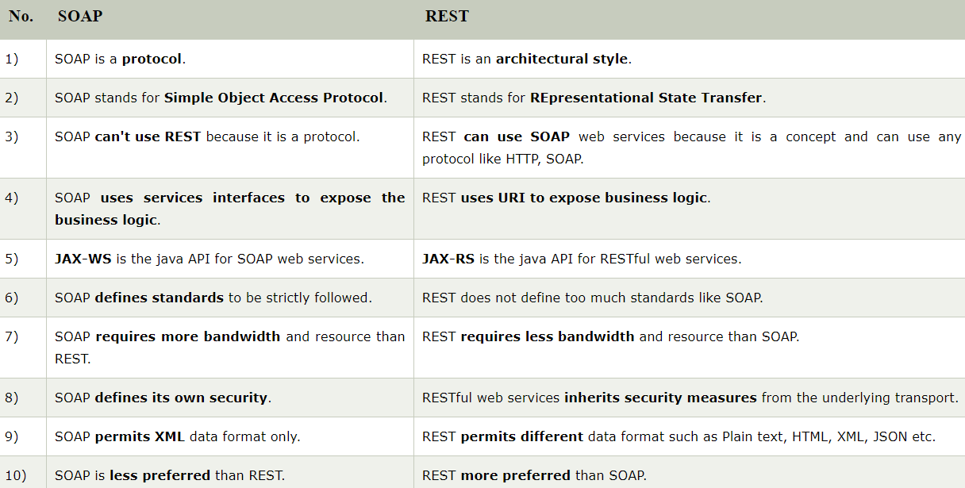

Slide 6
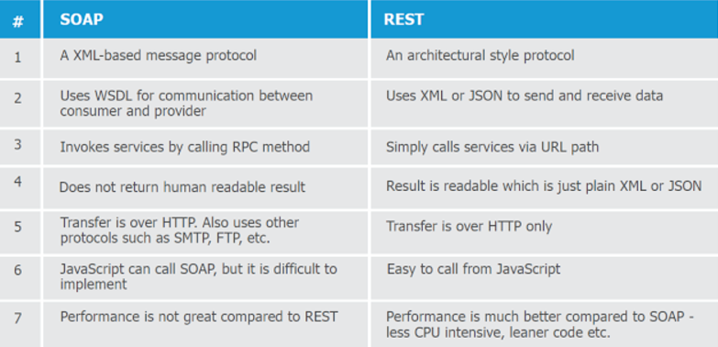

Slide 7
ASSERTIONS
Assertions: it is used to validate the response by comparing actual with expected result
Types of Assertions:
1. Property content
a. Contains
b. Equals
c. NotContains
d. Xpath Match -
used to validate the target property with the expected value
e. Xquery Match –
it uses xml path + relational database (diff clauses like for, where, order, by, for, let and return)
Advantages of Xpath over Xquery:
Using Xpath – we can only find large chunks of static data
Using Xquery – 1. we can check multiple node values with a single expression.
2. best use when there is static and dynamic data

Slide 8
ASSERTIONS
2. Compliance, status and http standards
a. Schema compliance h. SOAP response
b. SOAP fault g. WS – Addressing Request
c. not soap fault i. WS – Addressing Response
d. valid http status codes j. WS – Security status
e. Invalid http status codes k. swagger compliance assertion
f. http header equals
g. http header exists
3. Script 6. JMS Response: JMS Status and JMSTimeout
Script Assertion : it will run a customised script
4. SLA
Response SLA : it validates whether the last received response is within the time frame
5. Security
Sensitive Information Exposure : it will check whether the received response is not exposing any sensitive information

Slide 9
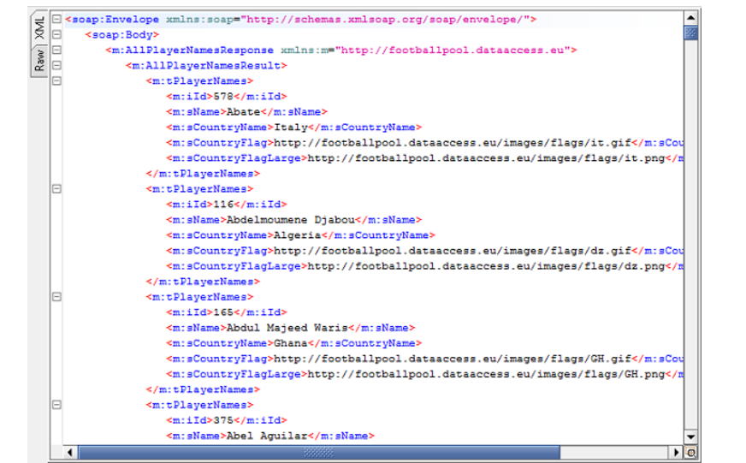
Example - Xquery

Slide 10
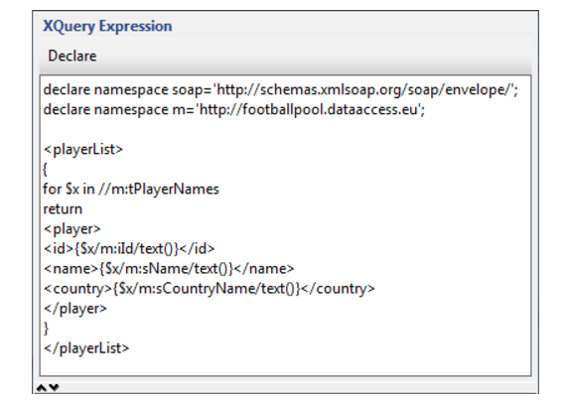
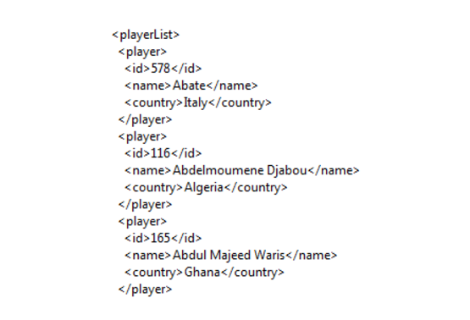
Example - Xquery

Slide 11
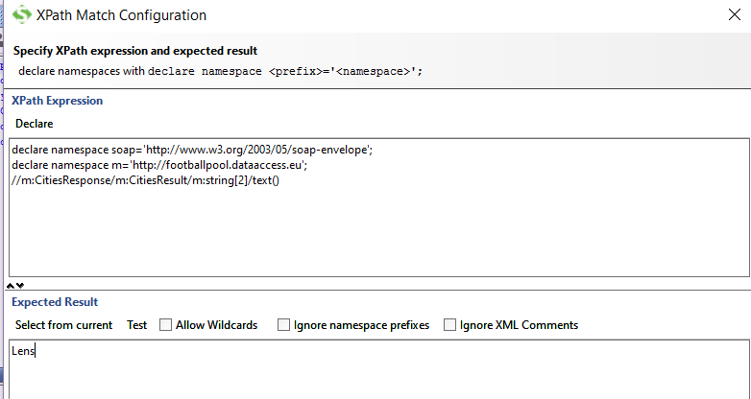
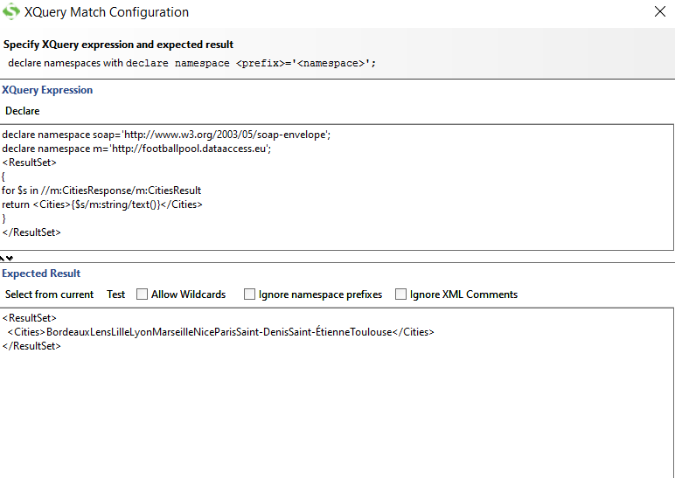
Comparision between Xpath and Xquery

Slide 12
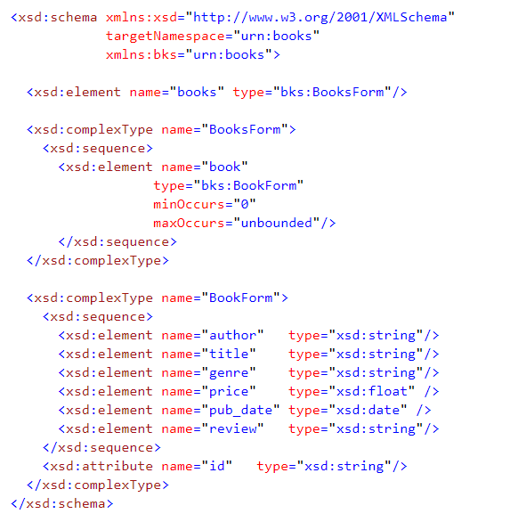
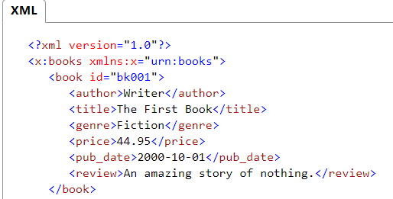
Validating XML with XSD:
XSD is an XMl schema definition language which defines the structure of an xml file (no of elements, order
And repetation of elements)
Xml – free set of elements and attributes

Slide 13
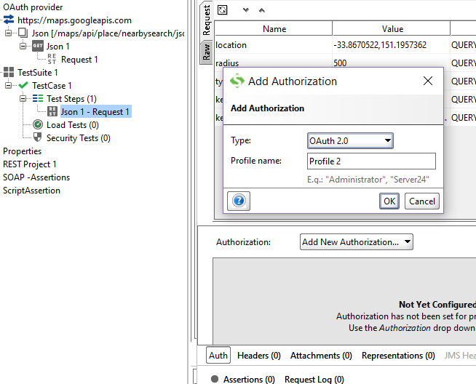
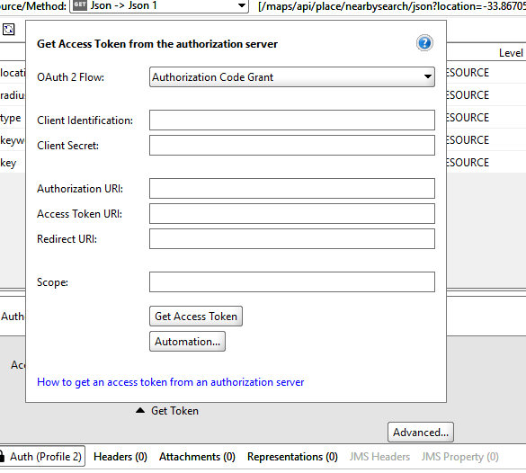
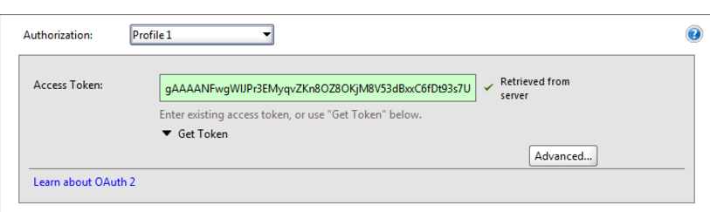
Oauth 2 provider: it is a 3-legged authentication which provides security when your transferring data between web Services through protocols like REST API.
1: create a rest project
2: now create test suite, test case and test step
3: click on auth at the bottom and add authorization method as Oauth 2.0
4. We need to access token for that we have to give our private details and register with the authorization Server
5. after submitting you will be authorized with the service along with access token when you send a request

Slide 14
Environment tab and service endpoints
https://www.soapui.org/soapui-projects/environment-handling.html
PROPERTIES
1.Custome Properties: (separate values)
Here this used for soap ui generic keywords like project, test suite and test case level
Syntax – ${#Project#name} , ${#TestSuite#id}, ${#TestCase#number}
2.Properties: (all the data in one sheet) – data source technique
This is what we actually create and use it so the syntax is
Syntax – ${Properties#name}
The above 2 ways of giving value in custom properties, this is called data driven test strategy

Slide 15
DATA-DRIVEN TESTING
When we store test data in some external file like database, excelsheets ,etc.., and then use that data into our project by some source like properties concept
Here DataSource - reads test data into properties from external source
SOAP UI PRO has Data source and Data source loop (we couldn’t get this in SOAP UI
Importance of Data Source:
When there is some large data which we want to test. So ,our web service will invoke with the help of excel sheet and we can loop that using data source loop feature
Data source: read the data from excel sheet
Data source loop: to iterate large amounts of data
Data sink: to export data to an excel sheet

Slide 16
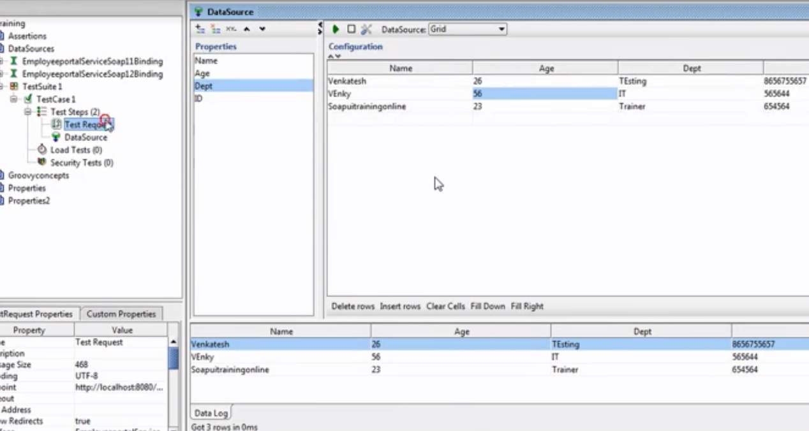
Implementation
Create a project and create test suite, test case and test step. Now, right on the test step and select data source.
Grid: (manual approach)
Select property name and select an option from the list like Grid from data source.
We have entered the values in the form of a table. When we run that it will ask how many records to compile and we executed.
3. Now these values can be accessible for our requests.

Slide 17
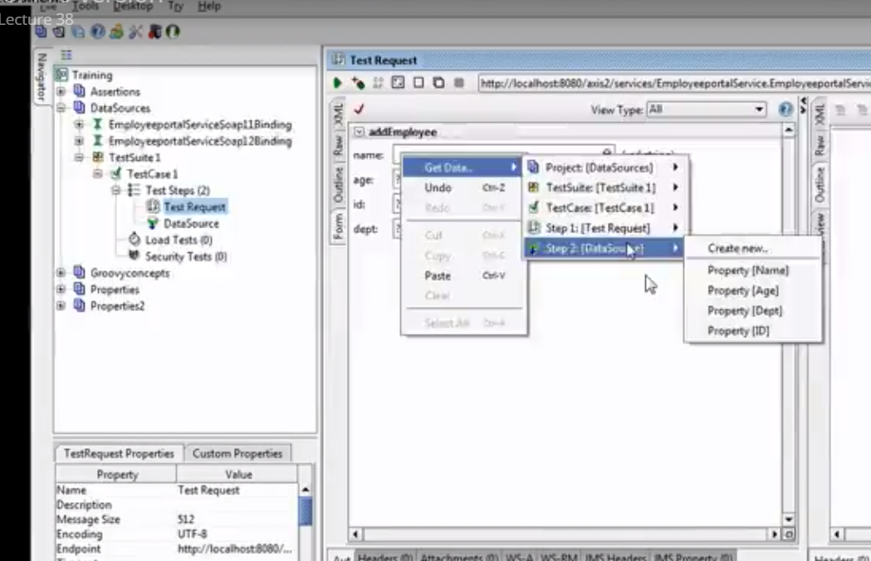
We have to select the grid properties to our request

Slide 18
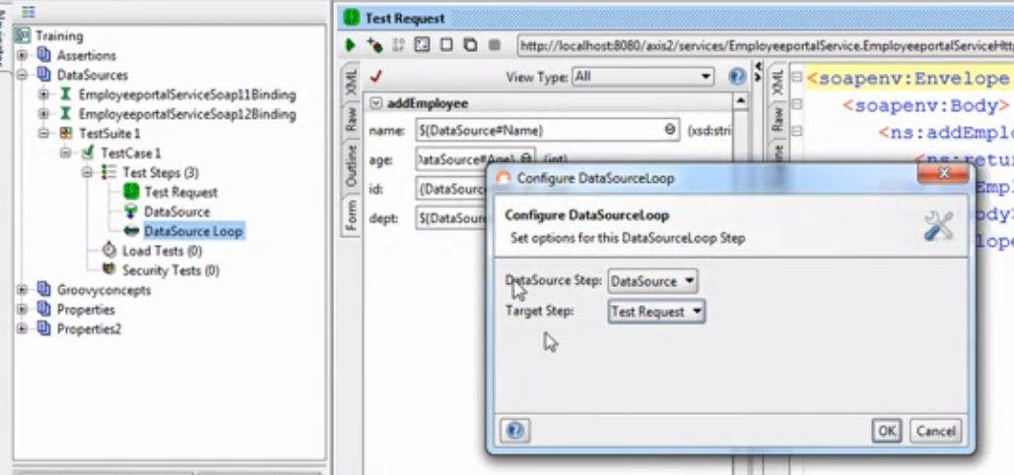
But, this type of selecting will be time taken every time so for that reason we have
another thing called data source loop (where all the rows will be iterated in one single click and if we
have 10 rows then all the 10 records will be updated in the database)
As the same way right click on the test step and select data source loop. Here we have give our data
Source and the request which we want to pass the data.

Slide 19
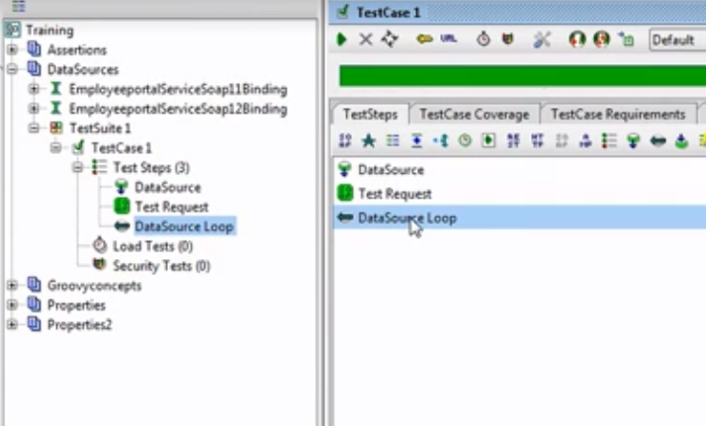
So, here first it will take data source and run the test request -> then when data
Source loop comes it will traverse from the second row and iterate through all the rows in one
Click. If we have 100 rows. We can add 100 records at one go.

Slide 20
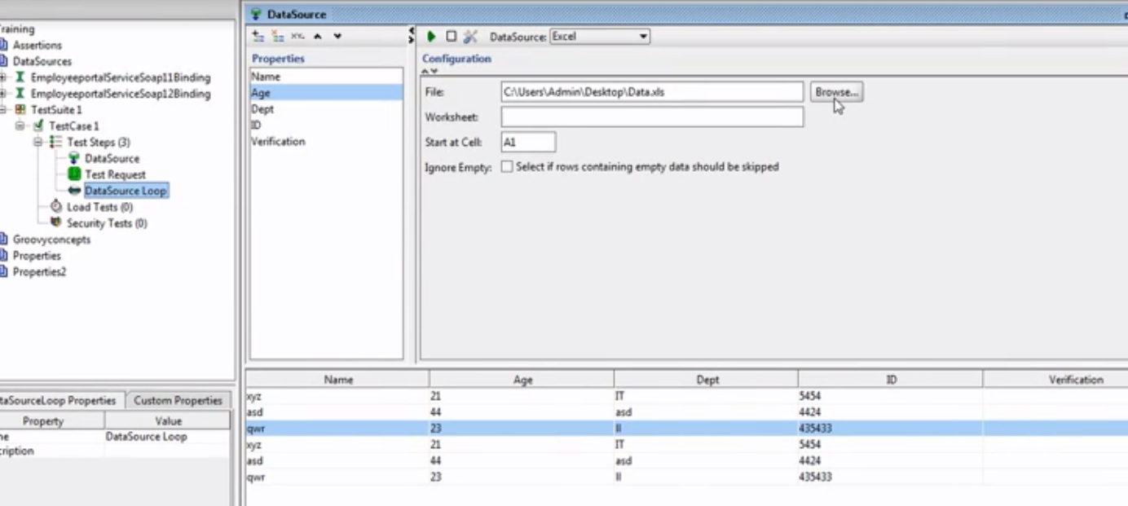
Excel sheet: Using this we can test large chunks of data at one go. The same way select excel form drop
Down and give the path and starting row of that.

Slide 21
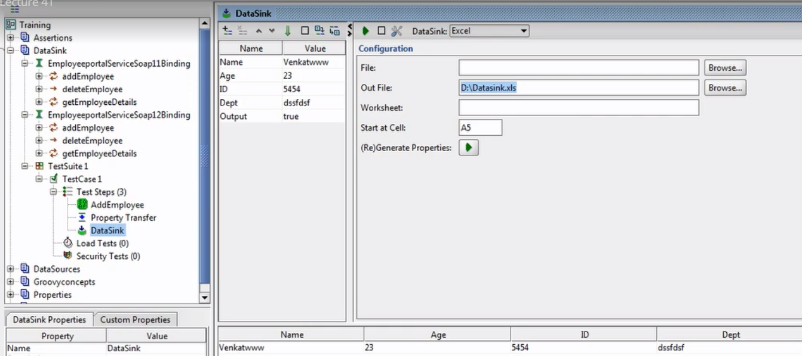
Data sink: (writing the data to excel sheets)

Slide 22
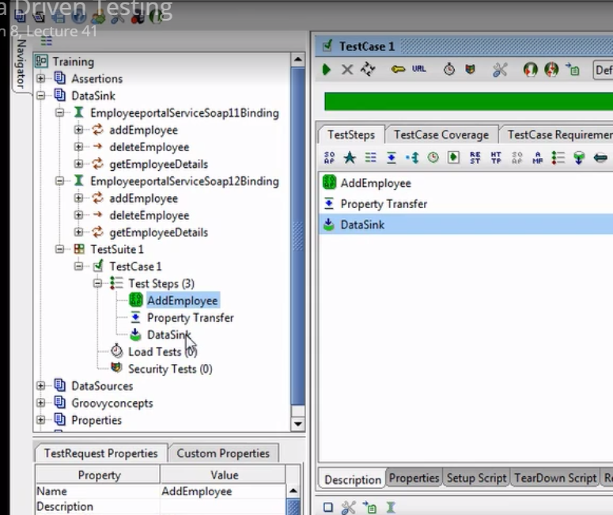
This way it executes the test cases step by step and save our results in an excel sheet

Slide 23
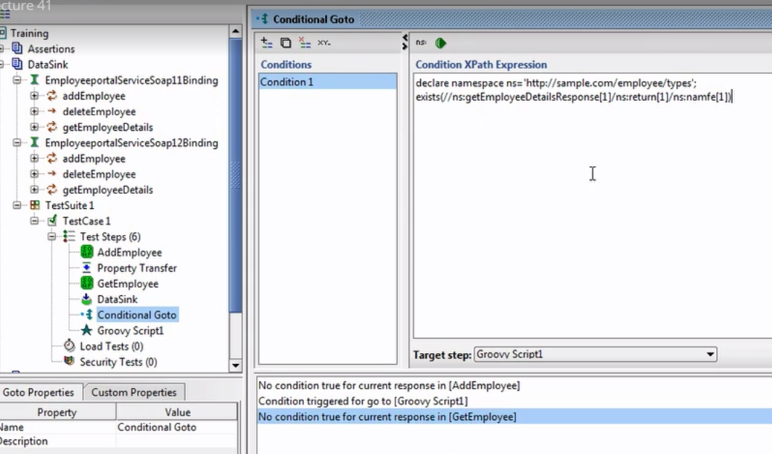
ConditionalGoTo: (based on the condition which we give in the script then it triggers the target step)
Here, it executes the nearest request. It is like if else loop (if is your xpath script then – target step) else
Groovy script will not execute
Delay: it is like sleep command in selenium

Slide 24
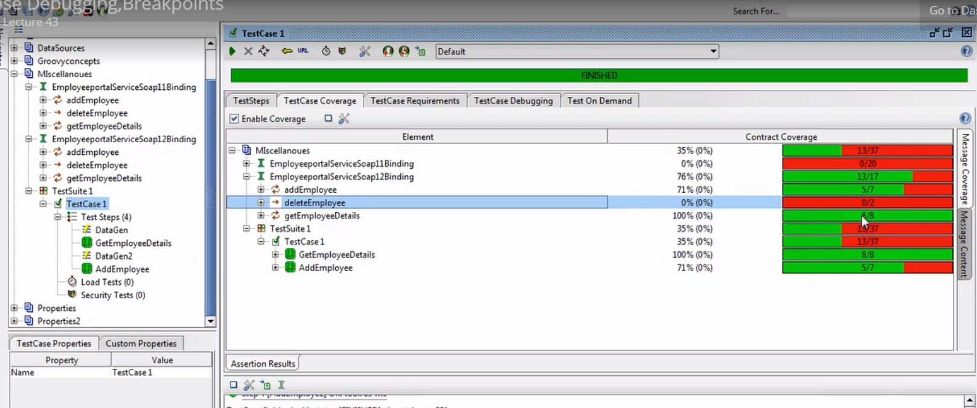
TestDebugging: it tells how to debug our test cases by placing breakpoints
TestCoverage: tells how much you have covered your test case

Slide 25
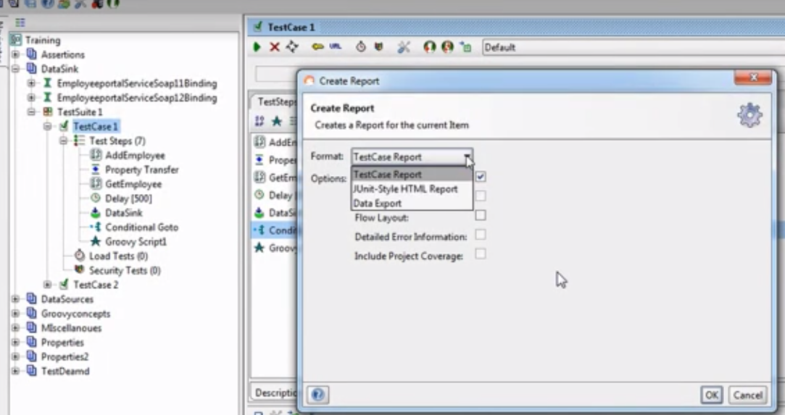
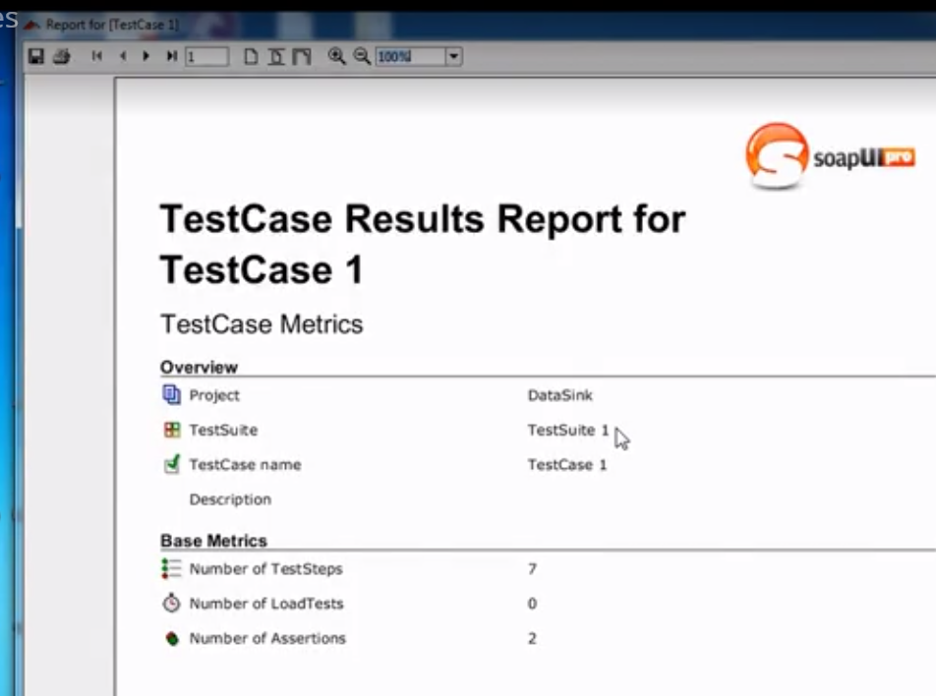
Reporting: we have to generate reports at the end that is how many test case We have ran (coverage), how many are passed – this is available in soap ui pro.
We have 3 options – junit-style html report, test case report, Data export
After the execution is done, we can select the report option and generate – convert to required format(word,pdf)
1. Test case report:

Slide 26
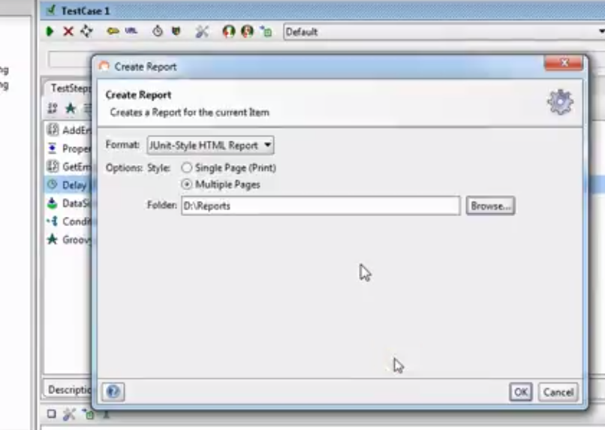
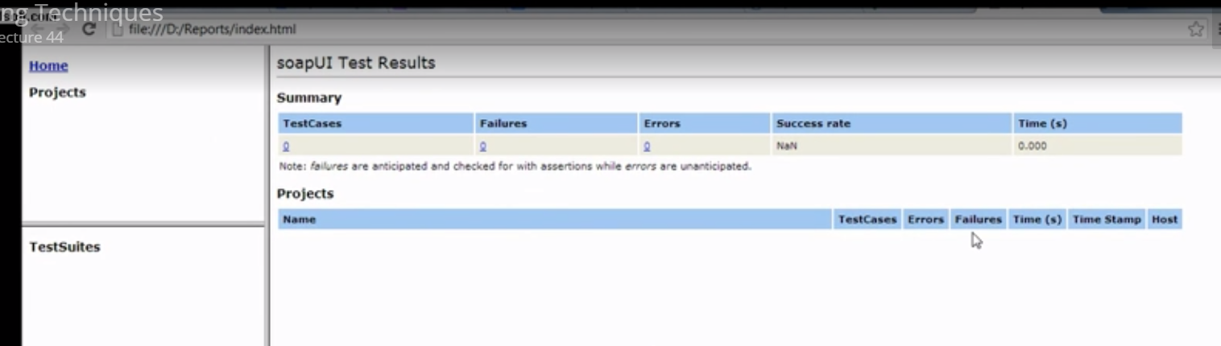
2. Junit –html reports: mostly this will be used by industries

Slide 27
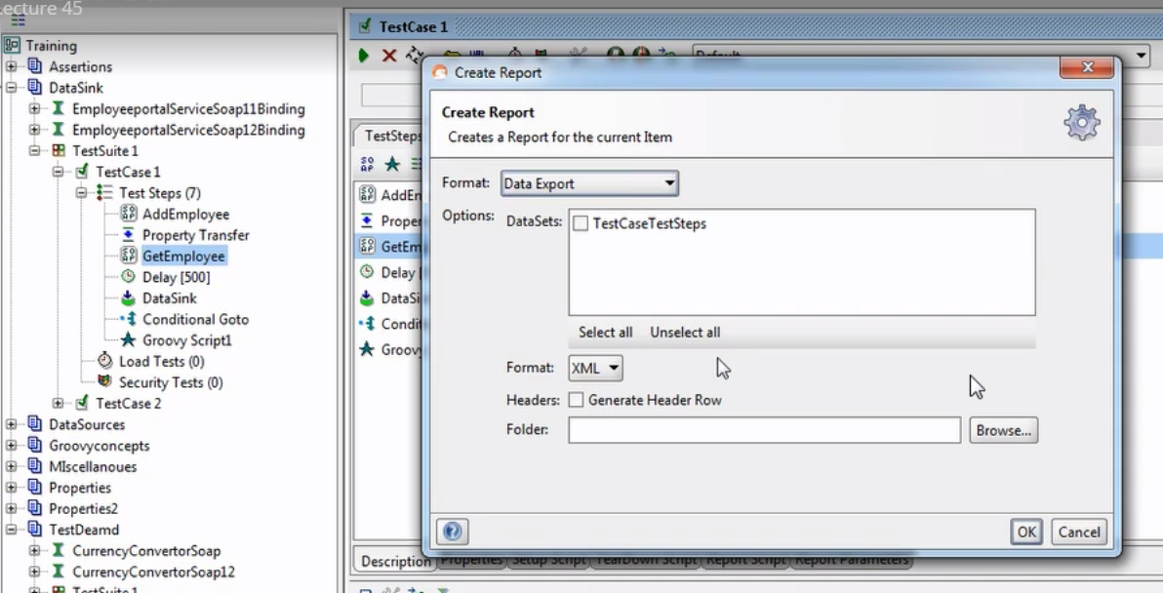
3. DataExport:

Slide 28
Property transfer
It is used when we want to transfer extract values from a response to specified request
2 ways to automate soap and rest services in SOAP UI tool for validating the responses
Groovy scripting – log ,context and testRunner variables (create by right click on test case and select groovy script)
Script Assertion – log, context and messageExchange variables (this is included in the assertion window)

Slide 29
Groovy Scripting
Right click on the test case -> select groovy script. As soon as you create that a script is invoked with log
It contains log, context and testRunner variables and these play a major role.
With this 2 variables we can
1. call any operation like properties
2. run any operation
3. test any data
4. access request and response
Log:
Record all your operations and print in console
Context:
Scope lies in test case level. So whatever you write inside the test case like properties, property transfer it will be handled.
Features of context:
For setting the property - just like we set custom properties
context.setProperty(“name”,”value”)
Example – context.setProperty(“Name”,”Sowmya”)
here it will set value Sowmya for Name

Slide 30
2. For getting the property – context.getProperty(“Name”)
We can access custom properties also
Ex – context.expand(‘${#TestCase#Name}’)
Expand: it is used to access the elements
We can take response and request also.
Ex – def response = context.expand(‘${NameOfRequest#response}’)
Here def – it acts like a variable
TestRunner:
Scope will be in the project level that is we can grab the custom properties, property transfer from project, test suite
We can set the properties at the run time( custom properties tab in test suite/test case and project level)

Slide 31
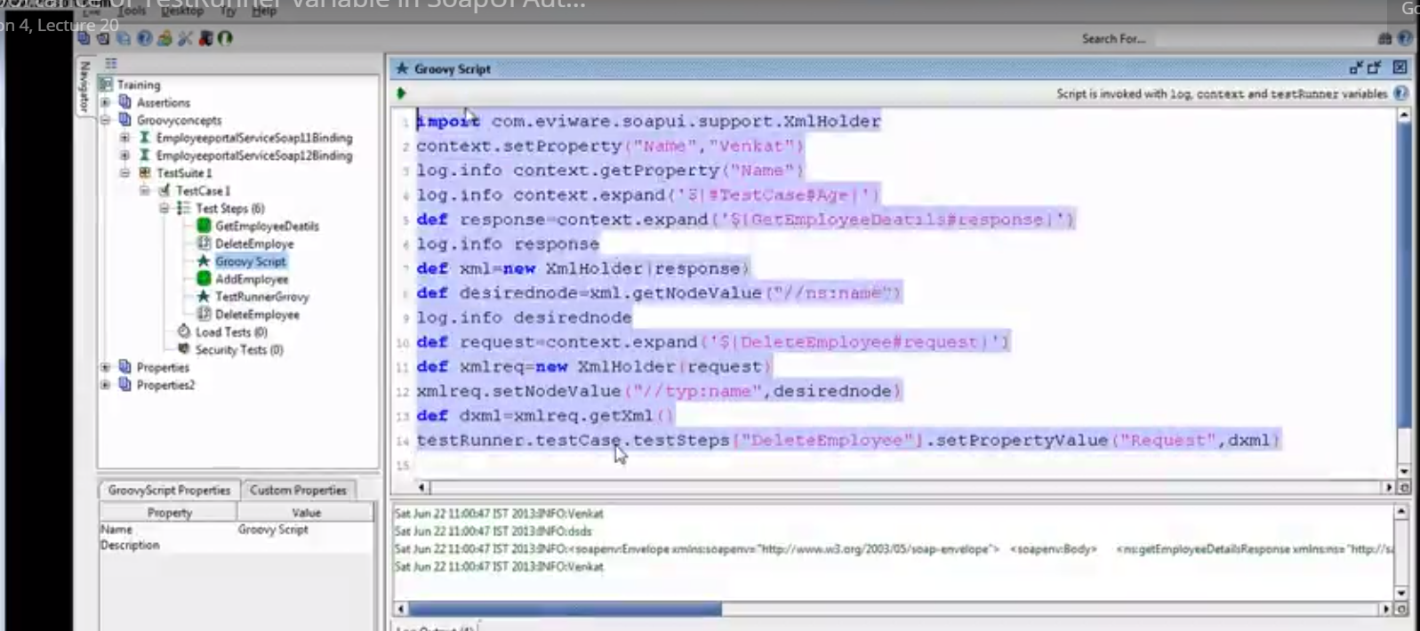

Slide 32
Exercise on groovy script
def response = context.expand(‘${Get#response}’)
Task-1 : get the hold of response
Import com.eviware.soapui.support.XmlHolder
def xml = new XmlHolder(response) // here response is sent as an argument, so that all the nodes will be stored in xml
XmlHolder: this package will load the xml which we send as an argument and seperates all the nodes. And will store this in one xml variable. So that we can access the desired node that we want.
Task-2 : get the desired node value from the response. There are 2 ways of getting the node value
def desiredNode = xml.getNodeValue(“//m:sName”)
2. def desiredNode = xml(“//m:sName”)
Task-3 : get the hold of request
Task-4 : put the desired node value in delete
Task-5 : update the xml

Slide 33
Till step-5 we have saved our request in local xml file but in order to update the value to the xml by setting the value dynamically and run we have use testRunner variable. Inorder to do that her is the syntax
First go to the respective level and in that set your property
testRunner.testCase.testSteps[“DeleteEmployee”].setPropertyValue(“Request”,dxml)
2. Now get the desired level to run
def desiredtestStep = testRunner.testcase.testSteps[“DeleteEmployee”]
3.To run our request from groovy script use run method by passing arguments
desiredtestStep.run(testRunner,context)
Note – here if our request is in the same testcase level then we can give context so it searches for the respective request and sometimes if it is in other test suites then we have to get that context and for that we have use WsdlTestRunnerContext. So, we have import the package
com.eviware.soapui.impl.wsdl.testcase.WsdlTestRunContext and give our path as an argument , then it will serach in that.

Slide 34
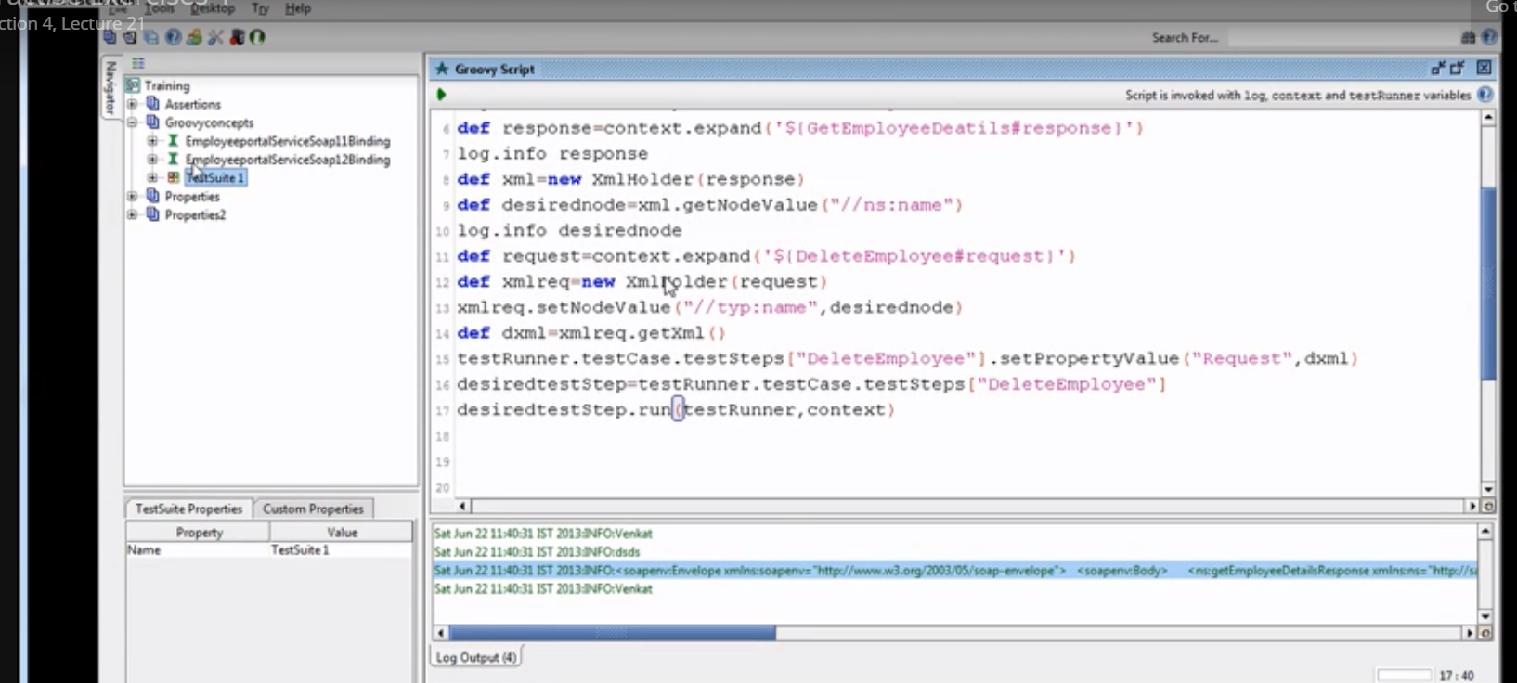

Slide 35
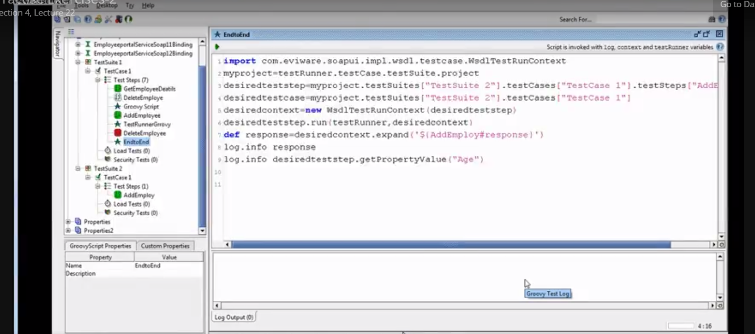

Slide 36
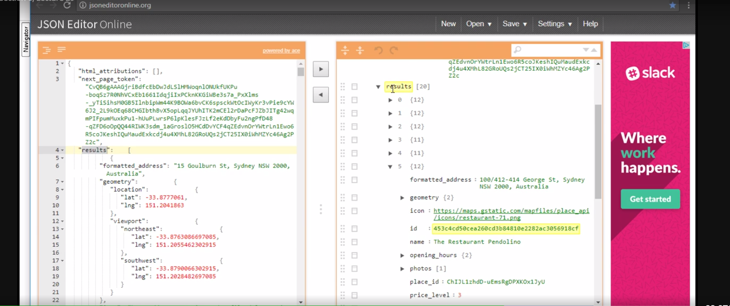
Script Assertion
Create a rest project -> in the assertion tab select Script Assertion and now since it is a json we have to understand how many nodes it has and it can be done through json editor. So here we have 20 arrays that is 20 diff id’s

Slide 37
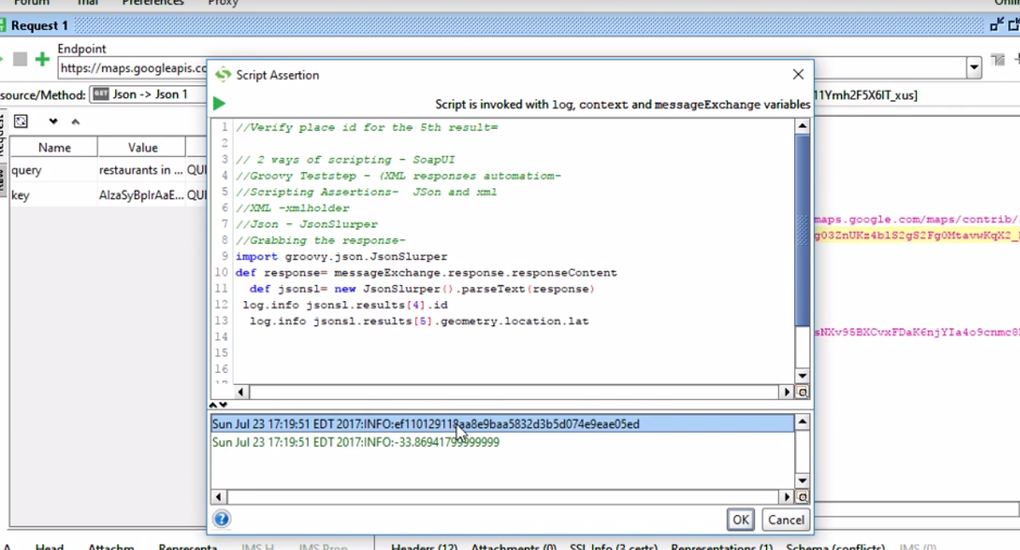
Now, first in order to get the response – import groovy.json.JsonSlurper
we have to use messageExchange variable
To parse response we have to use JsonSlurper. Since json is an object notation we have to use “.”
For getting the value from the response we have to traverse and below is the code

Slide 38
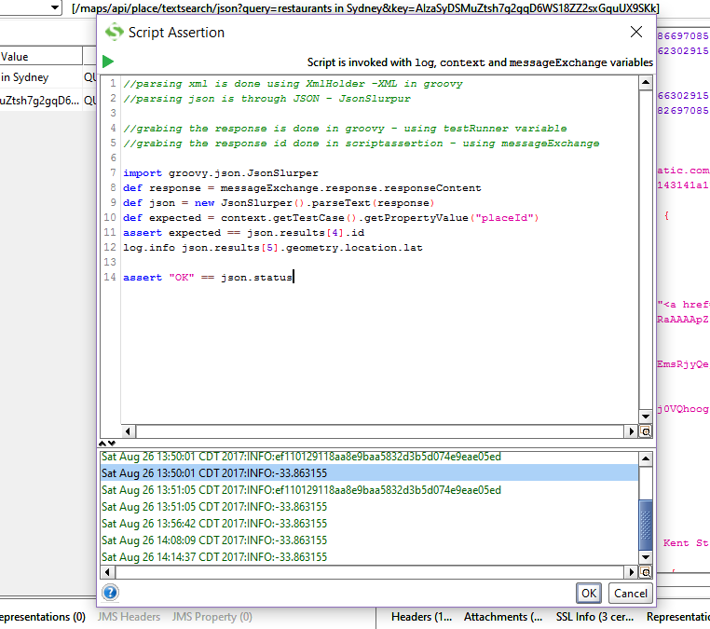
In order to compare the responses we have to Traverse with the help of context and we can get the value in the custom properties. So, now we can compare using assert (actual and expected Values)
Here json is like a main object so we can directly give Json.status

Slide 39
Important
Groovy Scripting:
1. grabing the response is done in groovy - using testRunner variable
2. parsing xml is done using XmlHolder -XML in groovy
3. For getting properties and running your test suite/testStep/testcase we have to use testRunner – run method an pass as the arguments.
4. When you want to update your json and xml files (or) to run the test cases you have to use groovy script
ScriptAssertion:
1. grabing the response is done in scriptassertion – using messageExchange
2. parsing json is through JSON – JsonSlurpur
3. For running here we have to use normal approach like go to the respective test case and test property and take the value from it.
4. If you want to validate the existing response using assertions you can use script assertion

Slide 40
Mocking services
Virtualization or simulation of web services is called mocking, that means even though the web service is not implemented completely we will use that once we invoke the WSDL file for testing. So, when the actual web service is ready we will take that.
Example: x(request) sends -> y(response) and based on y’s response x will interact with Z (end to end communication). So, here y is not implemented properly, but x and z are 100% implemented. So, without y they x and z cannot communicate each other. So in this case we will mock y (creating dummy webservice) and will take the data from it and conduct end to end testing and once it is implemented completely we will use it again.
Mocking can be useful because of the following things:
Especially in Regression testing – it is not always practical to call webservice every time because it may cause performance issues.
Web services are the integration of Heterogeneous (different) applications of SOA. So, one web service may connect to different web service which is outside of your organization.
Services are blocked by firewalls
Notes:
Regression testing is a type of software testing which verifies that software which was previously developed and tested still performs the same way after it was changed or interfaced with other software. Changes may include software enhancements, patches, configuration changes, etc.

Slide 41
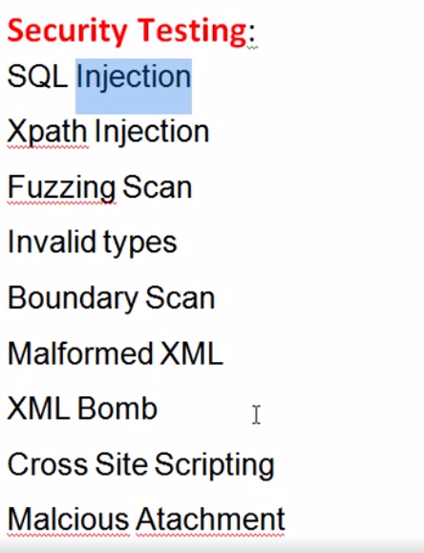
Security Testing
These are diff types of security threats which we have to check
SQL Injection:
Make sure that all the SQL queries written by developer are not leaked (that is by including special characters and symbols by hackers)
So, as a tester we have to make sure no leakage is present in web application or webservice or not.
Xpath Injection:
Make sure that your XML structure is not leaked

Slide 42
Fuzzy Scan:
If hacker doesn’t know any username and password then he may try some random data permutations and combinations to guess the credentials. So, in order to avoid this we have to keep secure authentications (after 3 unsuccessful attempts it should fail to login)
Invalid types:
Make sure the format is not leaked
Boundary Scan:
Make sure that the hacker shouldn’t know the Limit of the password like say 5letters

Slide 43
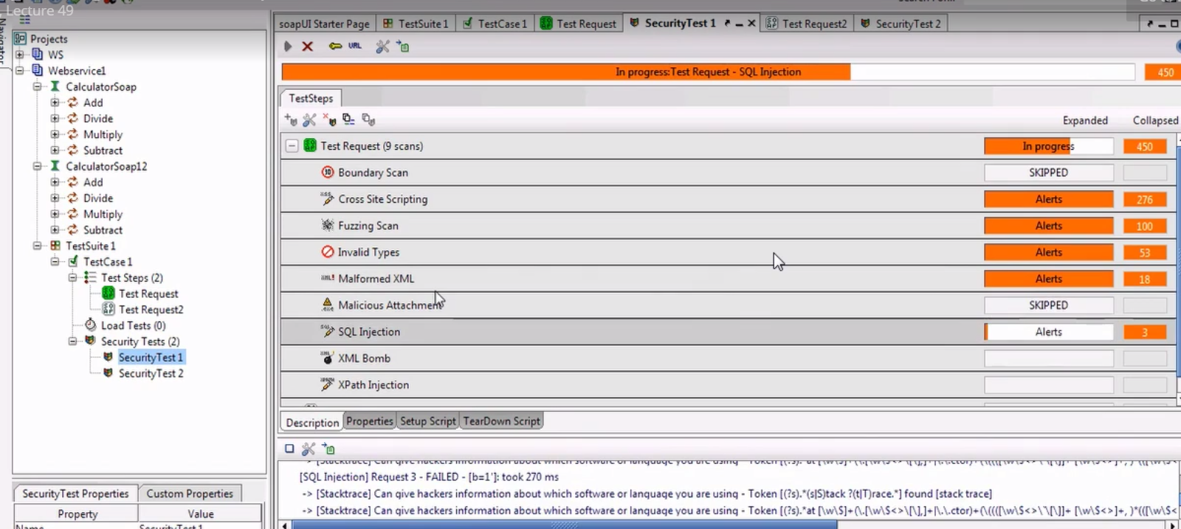
Implementation:
Step-1: create a soap project -> create test suite, test case and test step
Step-2: right click on security test step and click new security test

Slide 44
Database testing in soap UI
Scenario: when we want to send a request by taking data from database to another webservice and
checking the response by using assertions to validate the actual and expected values.
Connecting to server:
1. First, download my sql and now go to program files and copy this path
C:\Program Files\MySQL\MySQL Server 5.7\bin and paste it in command prompt
2. Now, for the connection -provide username and pwsd then run this command after that
mysql –h localhost –u root –p (here –h is localhost, -u is username and –p is password) – for windows 7
mysql –u root –p (-for windows 10)
After that you will be prompted to enter pswd, so now we are running on local host
Database Creation:
Now create a database by running this command
Create database SOAPUI;
Now inorder to use a particular database we have to run the command use database name;
Creating table and inserting values:
Run this command – create table Training;
Run this command – insert into Training values();

Slide 45
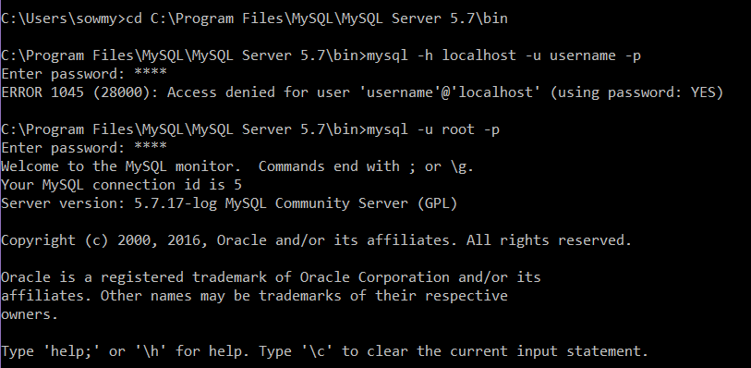
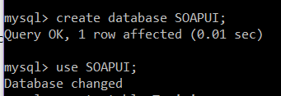

Slide 46
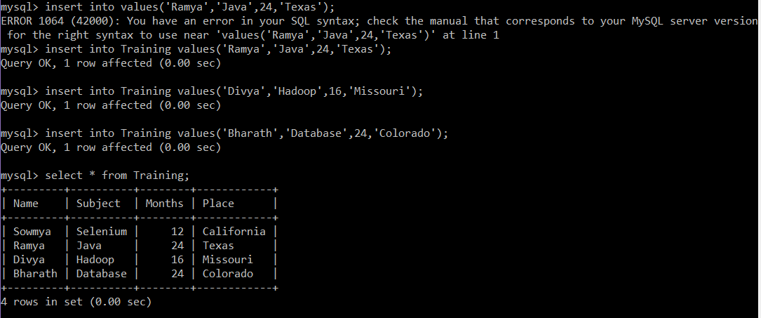

Slide 47
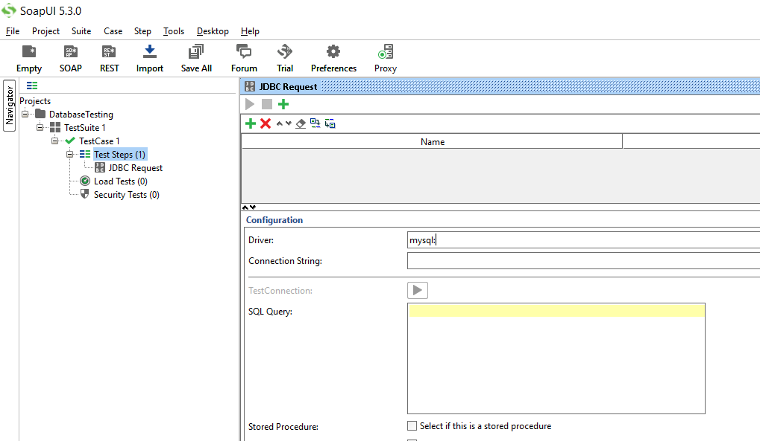
Now, for testing soapui we have to create a soap project without wsdl file and add step as JDBC request.

Slide 48
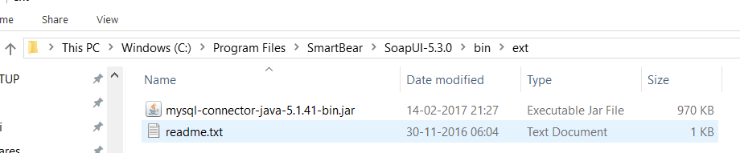
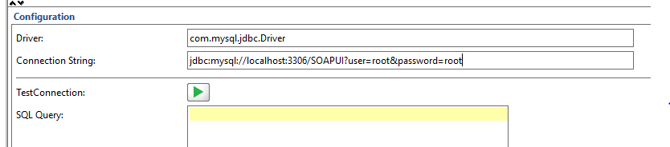
Now we have to get connection from the database for that we have to mention the following things like
Download mysql jdbc jar file which is com.mysql.jdbc.driver because this jar supports as a basic for
executing our queries. We have to paste this jar file like below
We have to configure the database for with soap ui for database testing

Slide 49
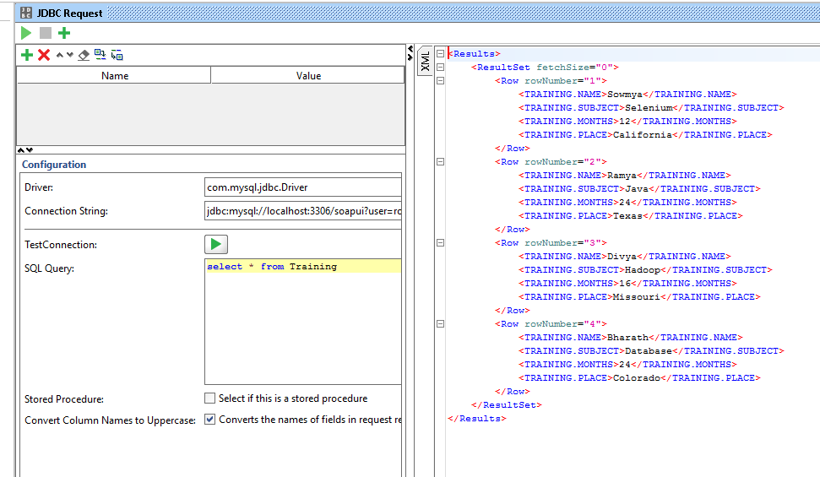

Slide 50
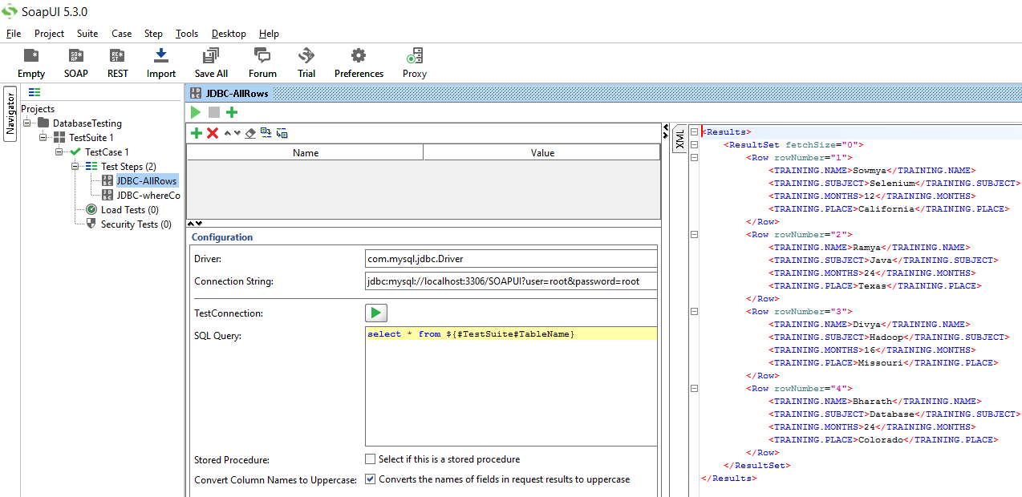
Now, not only retrieving the data from the database (through hard coding), we can also set the values
from custom properties and can run the query.
1. For selecting all rows from the table

Slide 51
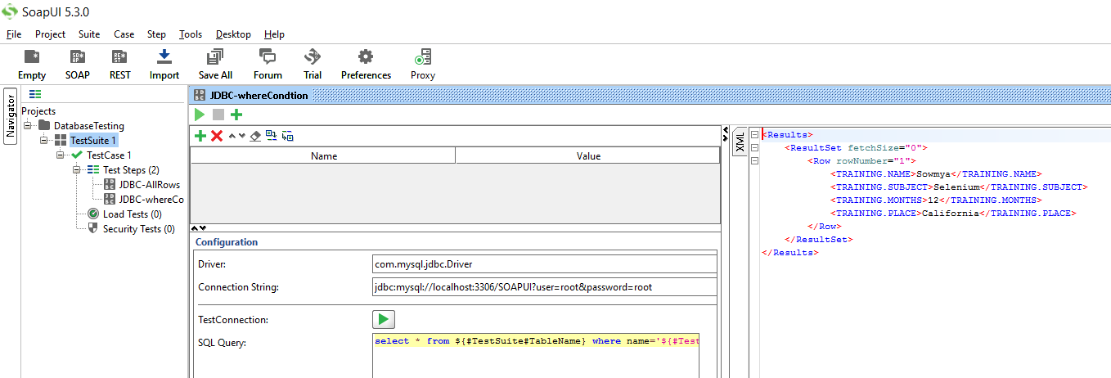
2. For selecting based on a condition

Slide 52
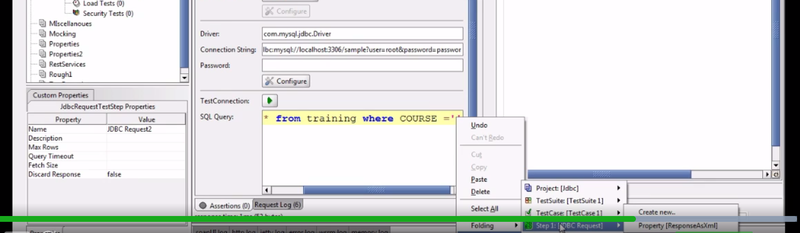
For selecting a value from previous response as input

Slide 53
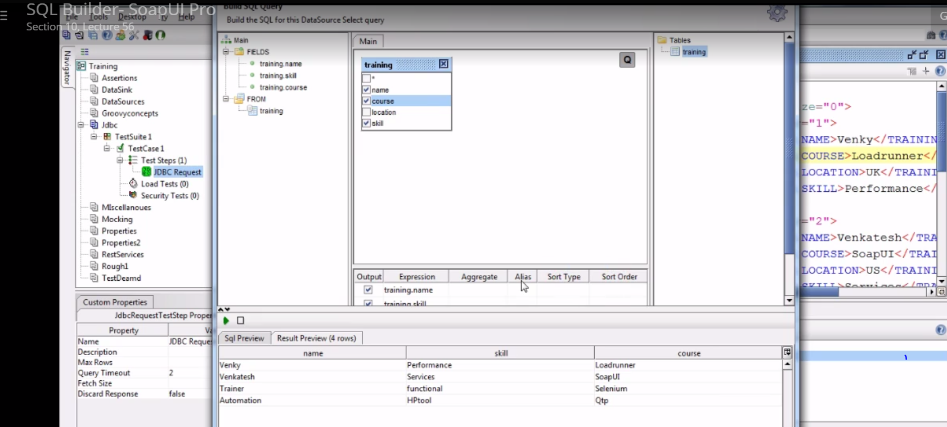
SOAP UI PRO: we can have build query feature. With that we can select whatever rows we want instead of writing in the form of a query and in output we will have an outline

